Slide 1
INTEGRATED ATHLETE MANAGEMENT SYSTEM
Proposal
Caitlyn Lefebvre, Sydney Eckstein & Stella Fruijtier

Slide 2
Project Overview
Integrated athlete management system that centralizes academic and athletic scheduling

Slide 3
Target Users
Athletes
Coaches
Administrators
Athletic Trainers

Slide 4
Context
Problem
Solution
Difficulty of managing student and athlete schedules
Not all features available
Create database and web interface that consolidates all tools in one unique platform

Slide 5
Features
Scheduling System
Practice schedules
Check and book court availability, etc.
Game schedules
Communication
Team announcements
Direct messaging
Medical Records (Restricted Access)
Injury reports
Clearance status
Recovery tracking
Athlete Management
Create and update athlete profiles
Track eligibility status
Performance Tracking
Record game statistics
Store training metrics
Generate performance history

Slide 6

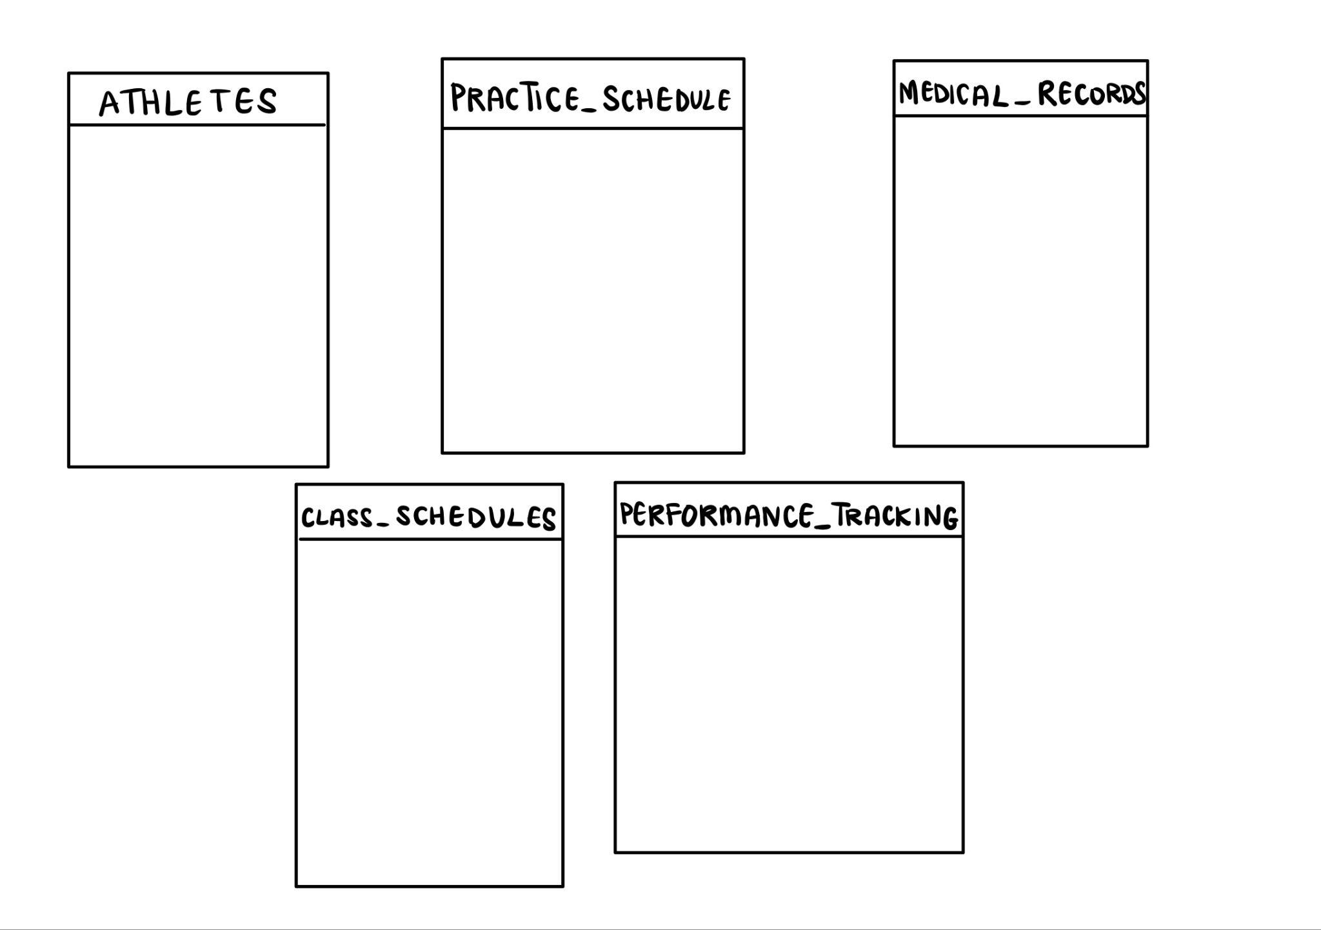
Rough Sketch
Database sketch

Slide 7
Task Distribution
Stella Fruijtier
Sydney Eckstein
Caitlyn Lefebvre
All
Database Architect / Team Lead
Backend Developer
Frontend Developer
Testing/Presentation/GitHub

Slide 8
Thank you
Q&A

